Slide 1

KHATRA ADIBASI MAHAVIDYALAYA
E-CONTENT
DEPARTMENT OF EDUCATION
SEMESTER-III (GE)
SESSION: 2020-2021
SUBJECT: EDUCATION
COURSE : EDUCATIONAL PSYCHOLOGY
COURSE CODE: AH/EDN/304/C-1C
TOPIC: THEORY OF SKINNER
NAME OF THE TEACHER: AKINCHAN PAL

Slide 2
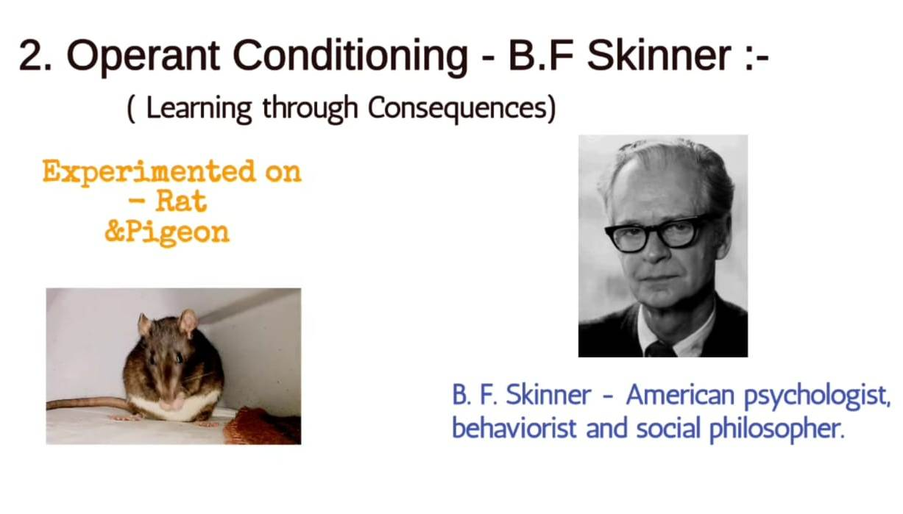

Slide 3
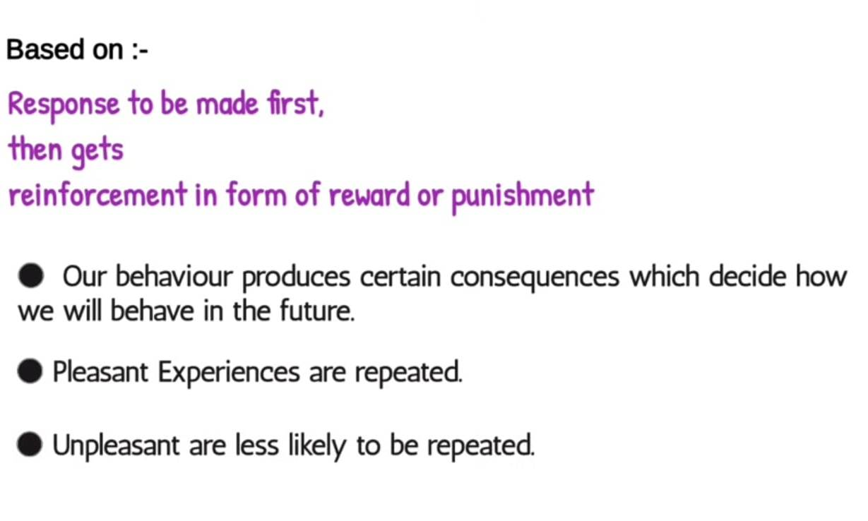

Slide 4
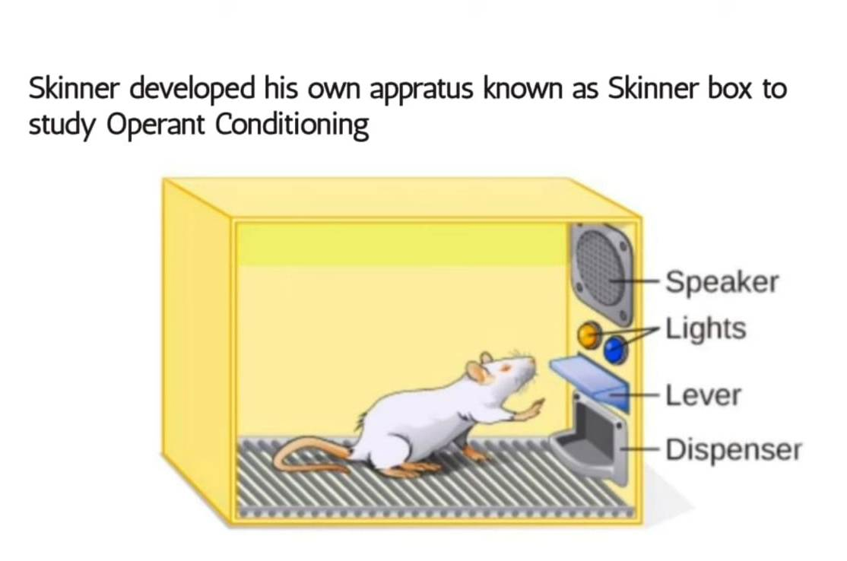

Slide 5
THANK YOU

